Slide 1
CUA REU
Week 4
Richard Lara

Slide 2
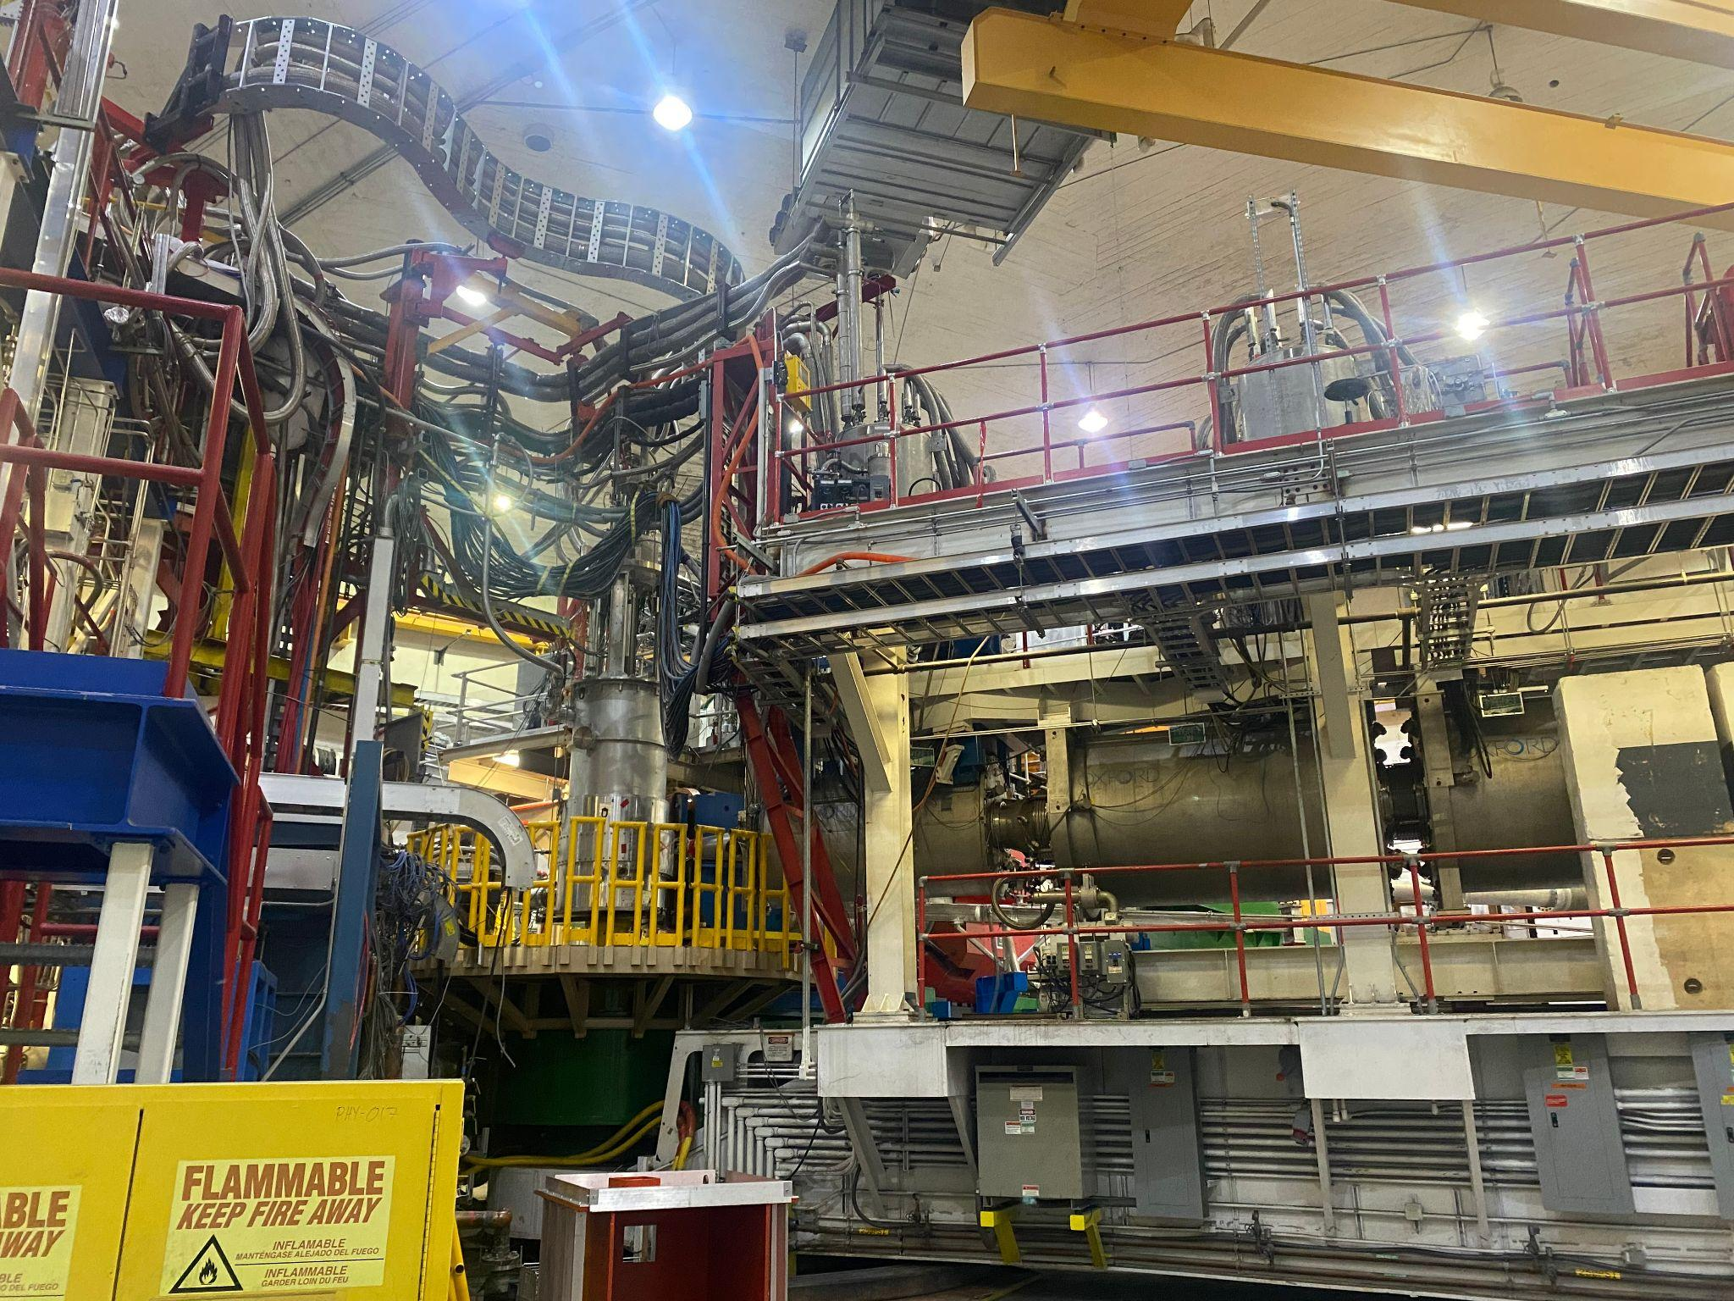

Tour of Hall C
Issues:
The drift chambers use a time parameter known as the “hodoscope start time” → hodoscope calibration is needed first
Target Chamber

Slide 3
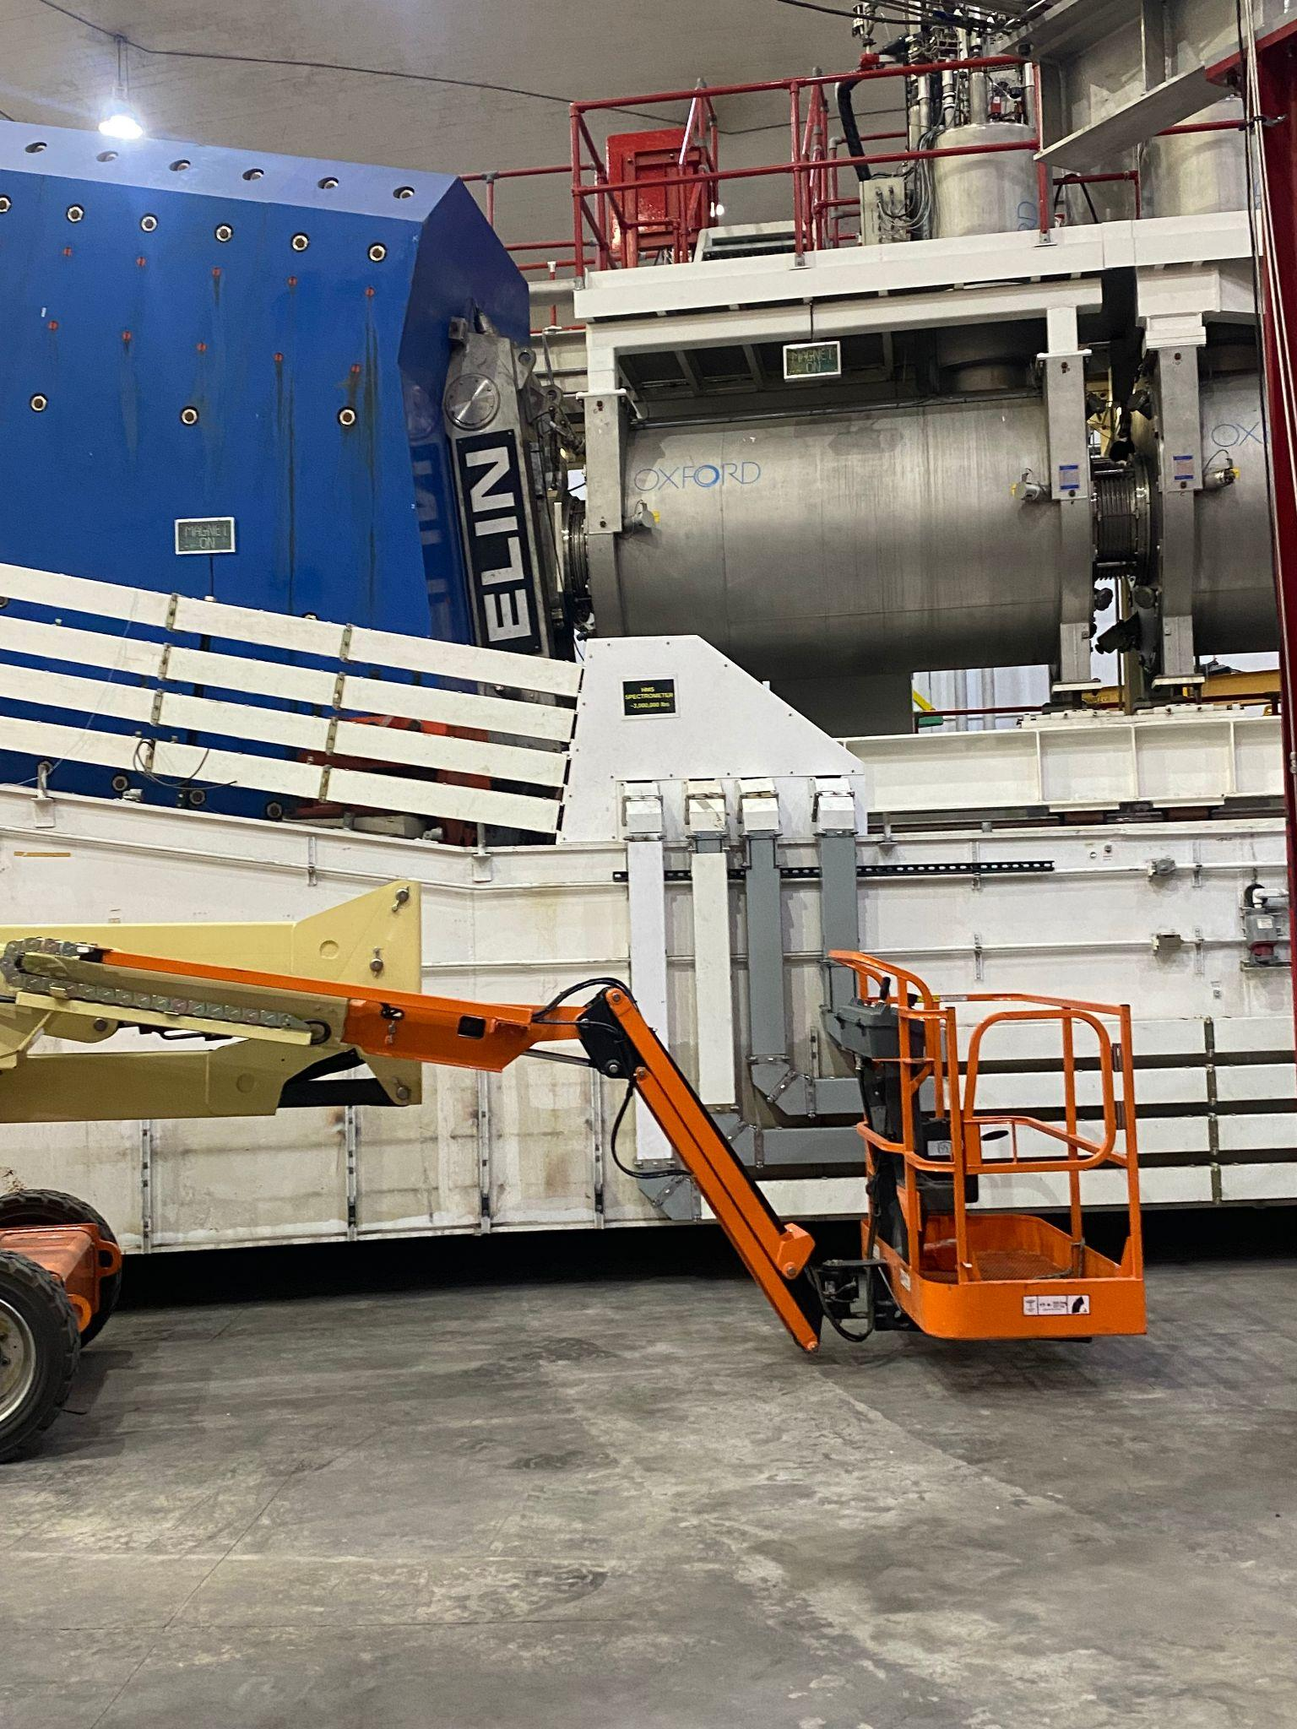
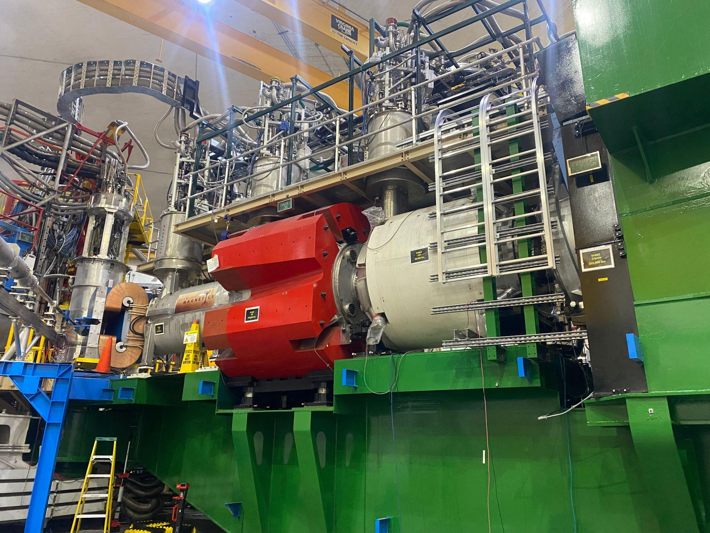
Q2
Q3
Dipole
Q1
HMS side view
SHMS Optics

Slide 4
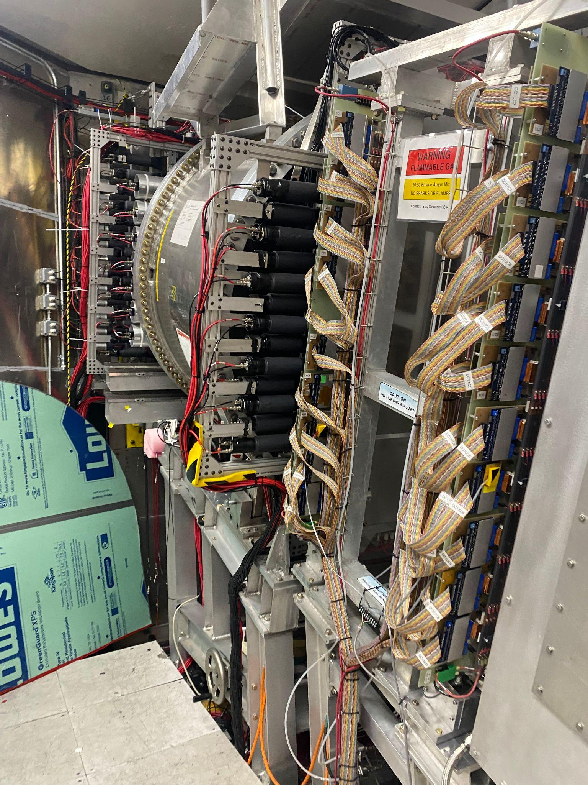
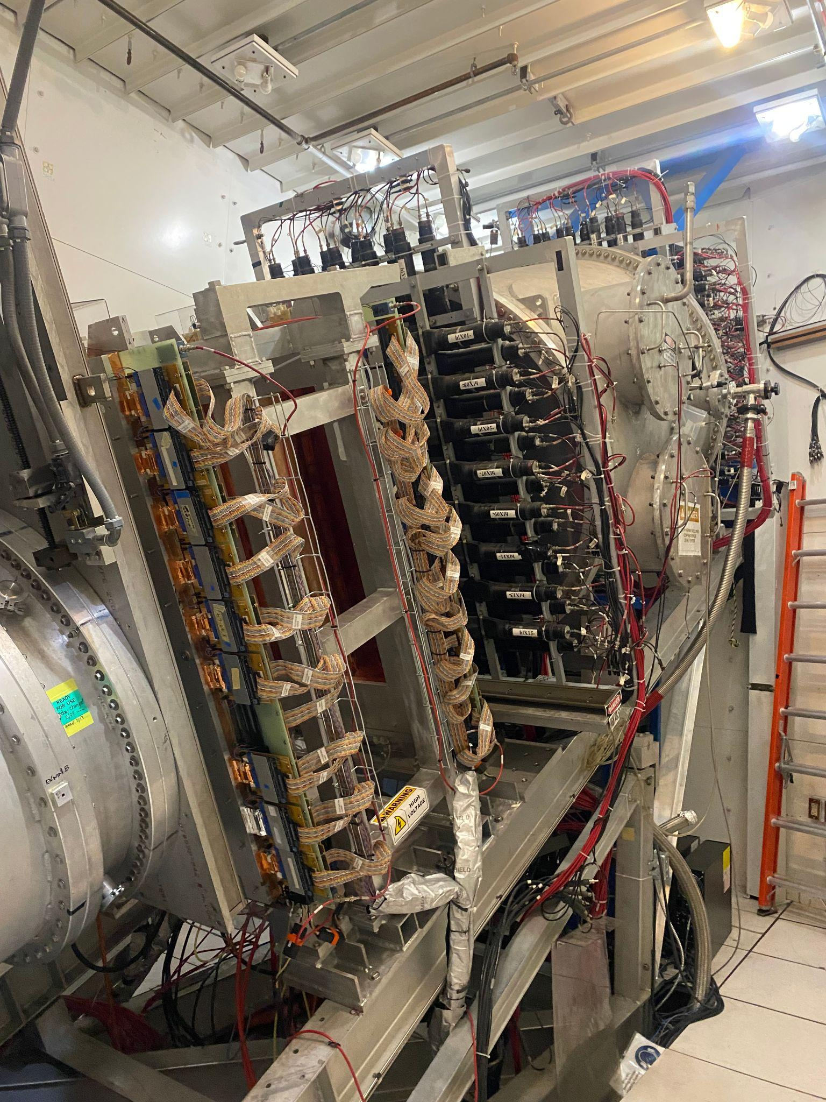
SHMS
HMS
Cherenkov Detector
Heavy Gas Cherenkov Detector
DC
DC
Vacuum Vessel
Noble Gas Cherenkov

Slide 5
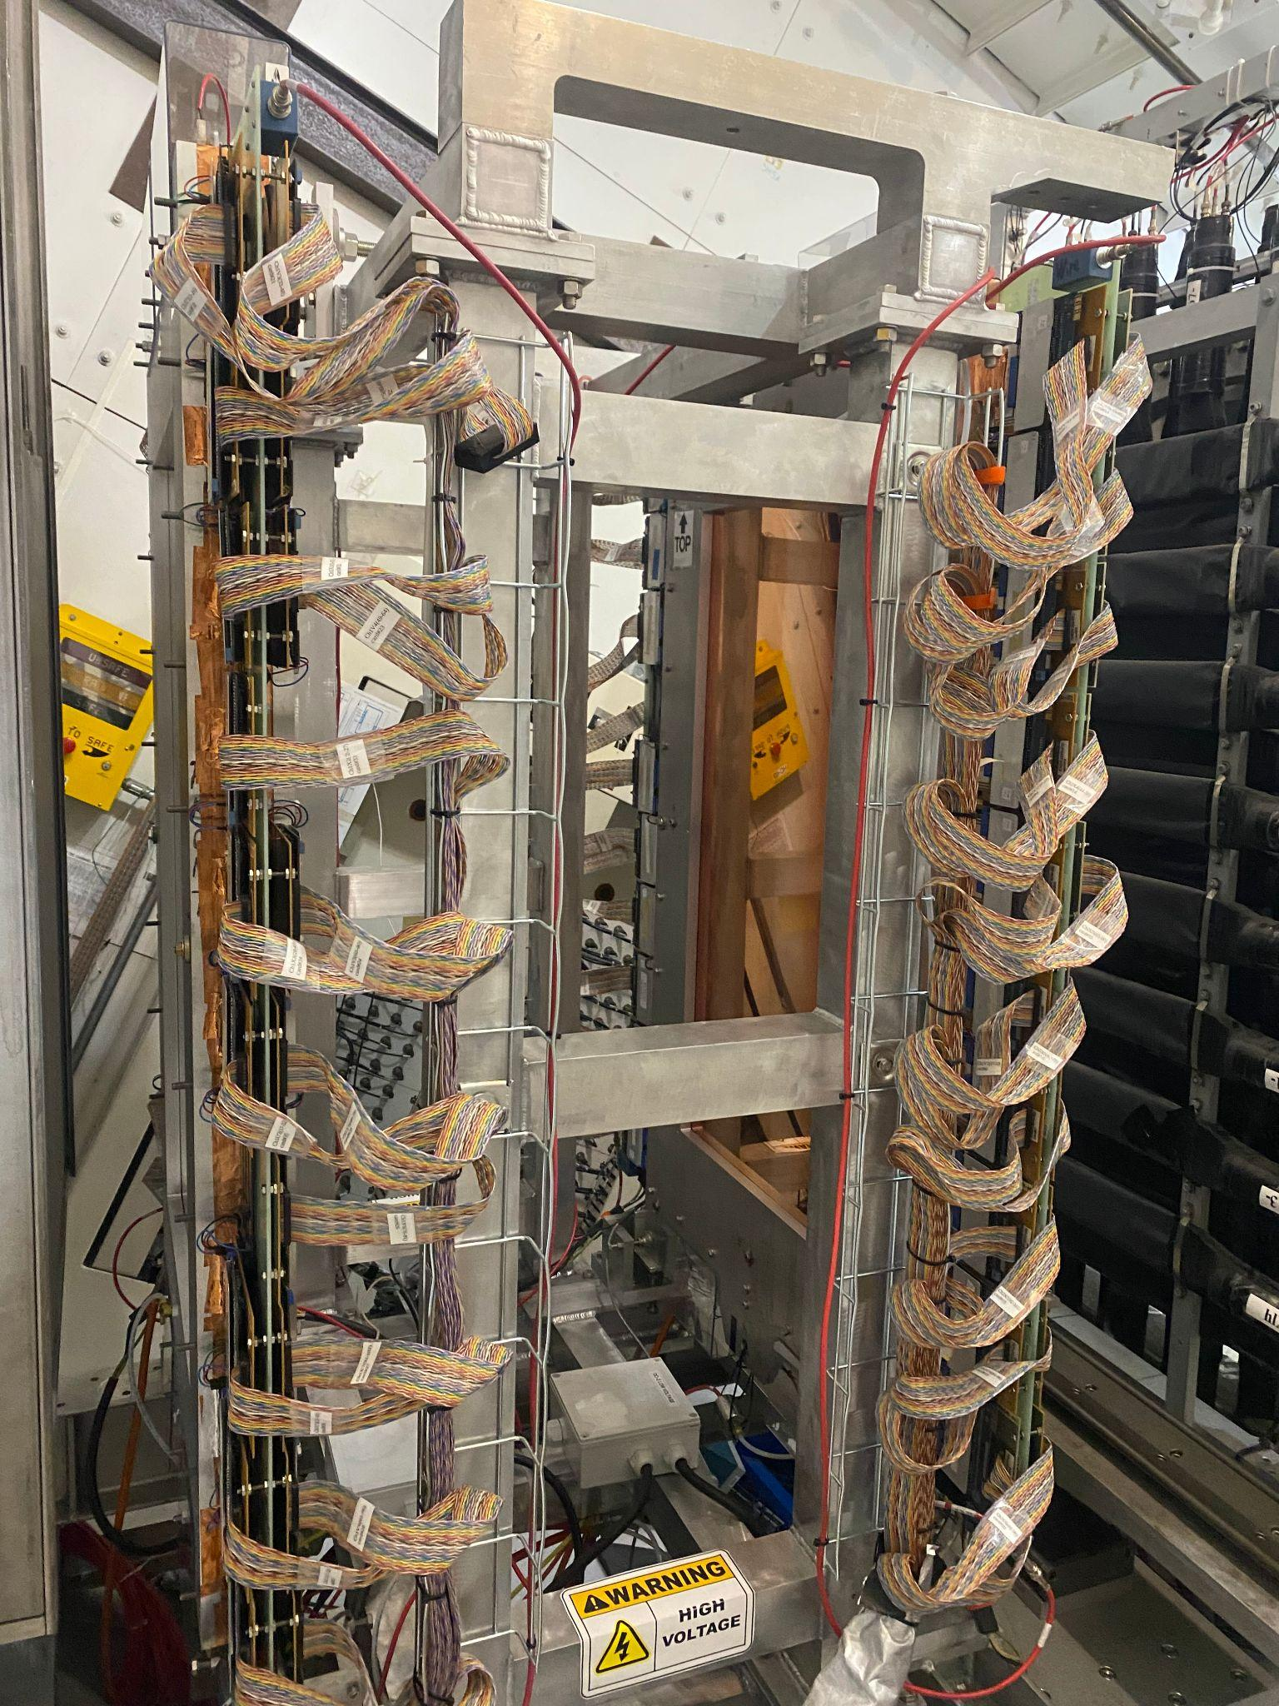
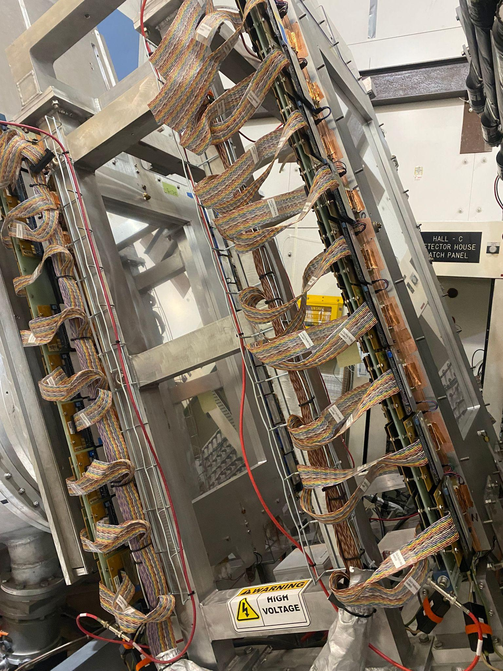
Drift Chambers

Slide 7
Next week…
Waiting on hodoscopes’ calibration parameter → obtained using defocused runs
Work on obtaining the calibrations parameters of the Drift Chambers using the defocused runs
Read the HMS and SHMS optics optimization sections from Dr. Yero’s thesis
Goal: Start and finish the drift chamber calibrations

